Slide 1
Pet a Dog
Sequence Diagram

Slide 2
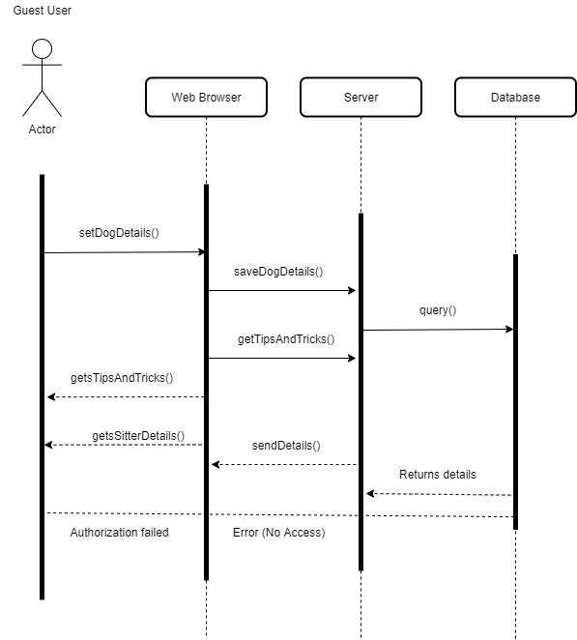
Pet a Dog – Sequence Diagram Use Case – 1.01 – Guest User

Slide 3
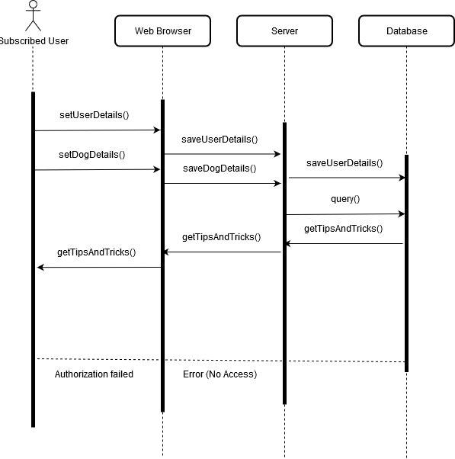
Pet a Dog – Sequence Diagram Use Case – 1.02 – Subscribed User

Slide 4
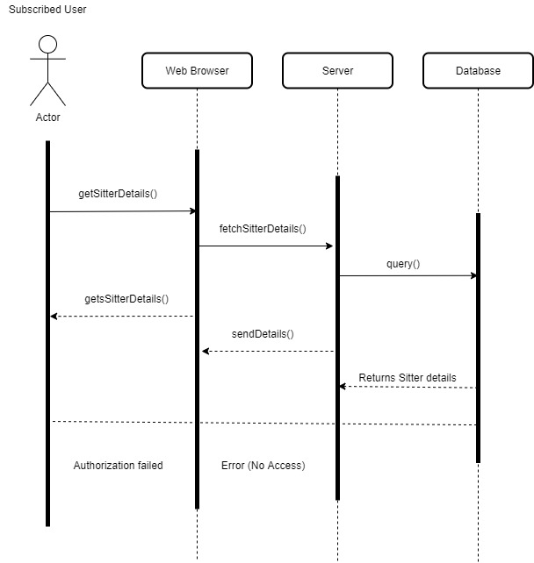
Pet a Dog – Sequence Diagram Use Case 2.1 – Searching a Sitter

Slide 5
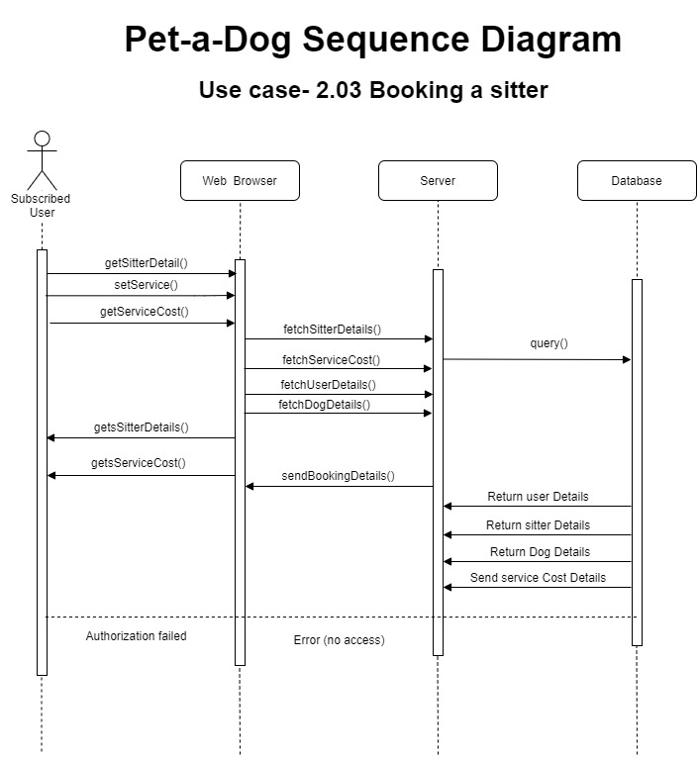

Slide 6
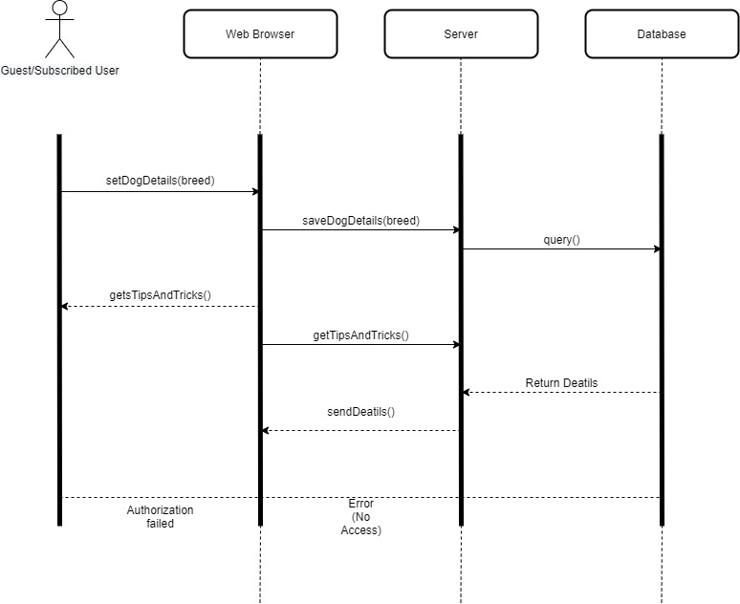
Pet a Dog – Sequence Diagram Use Case – 3.1 – Specifying the breed of the dog

Slide 7

Pet a Dog – Sequence Diagram Use Case – 3.2 – Specifying the measurements of the dog

Slide 8
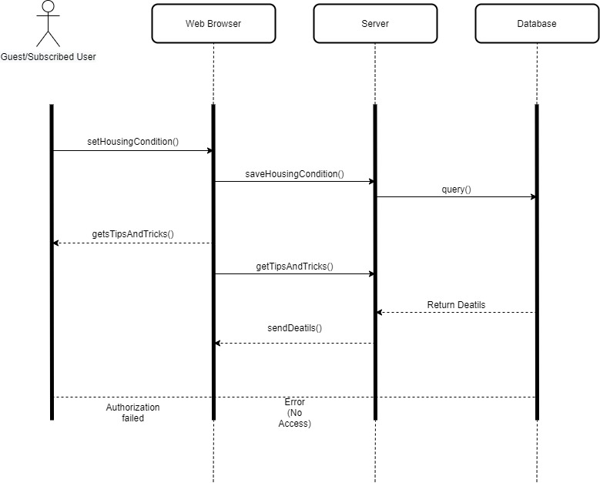
Pet a Dog – Sequence Diagram Use Case – 3.3 – Specifying housing condition

